Slide 1
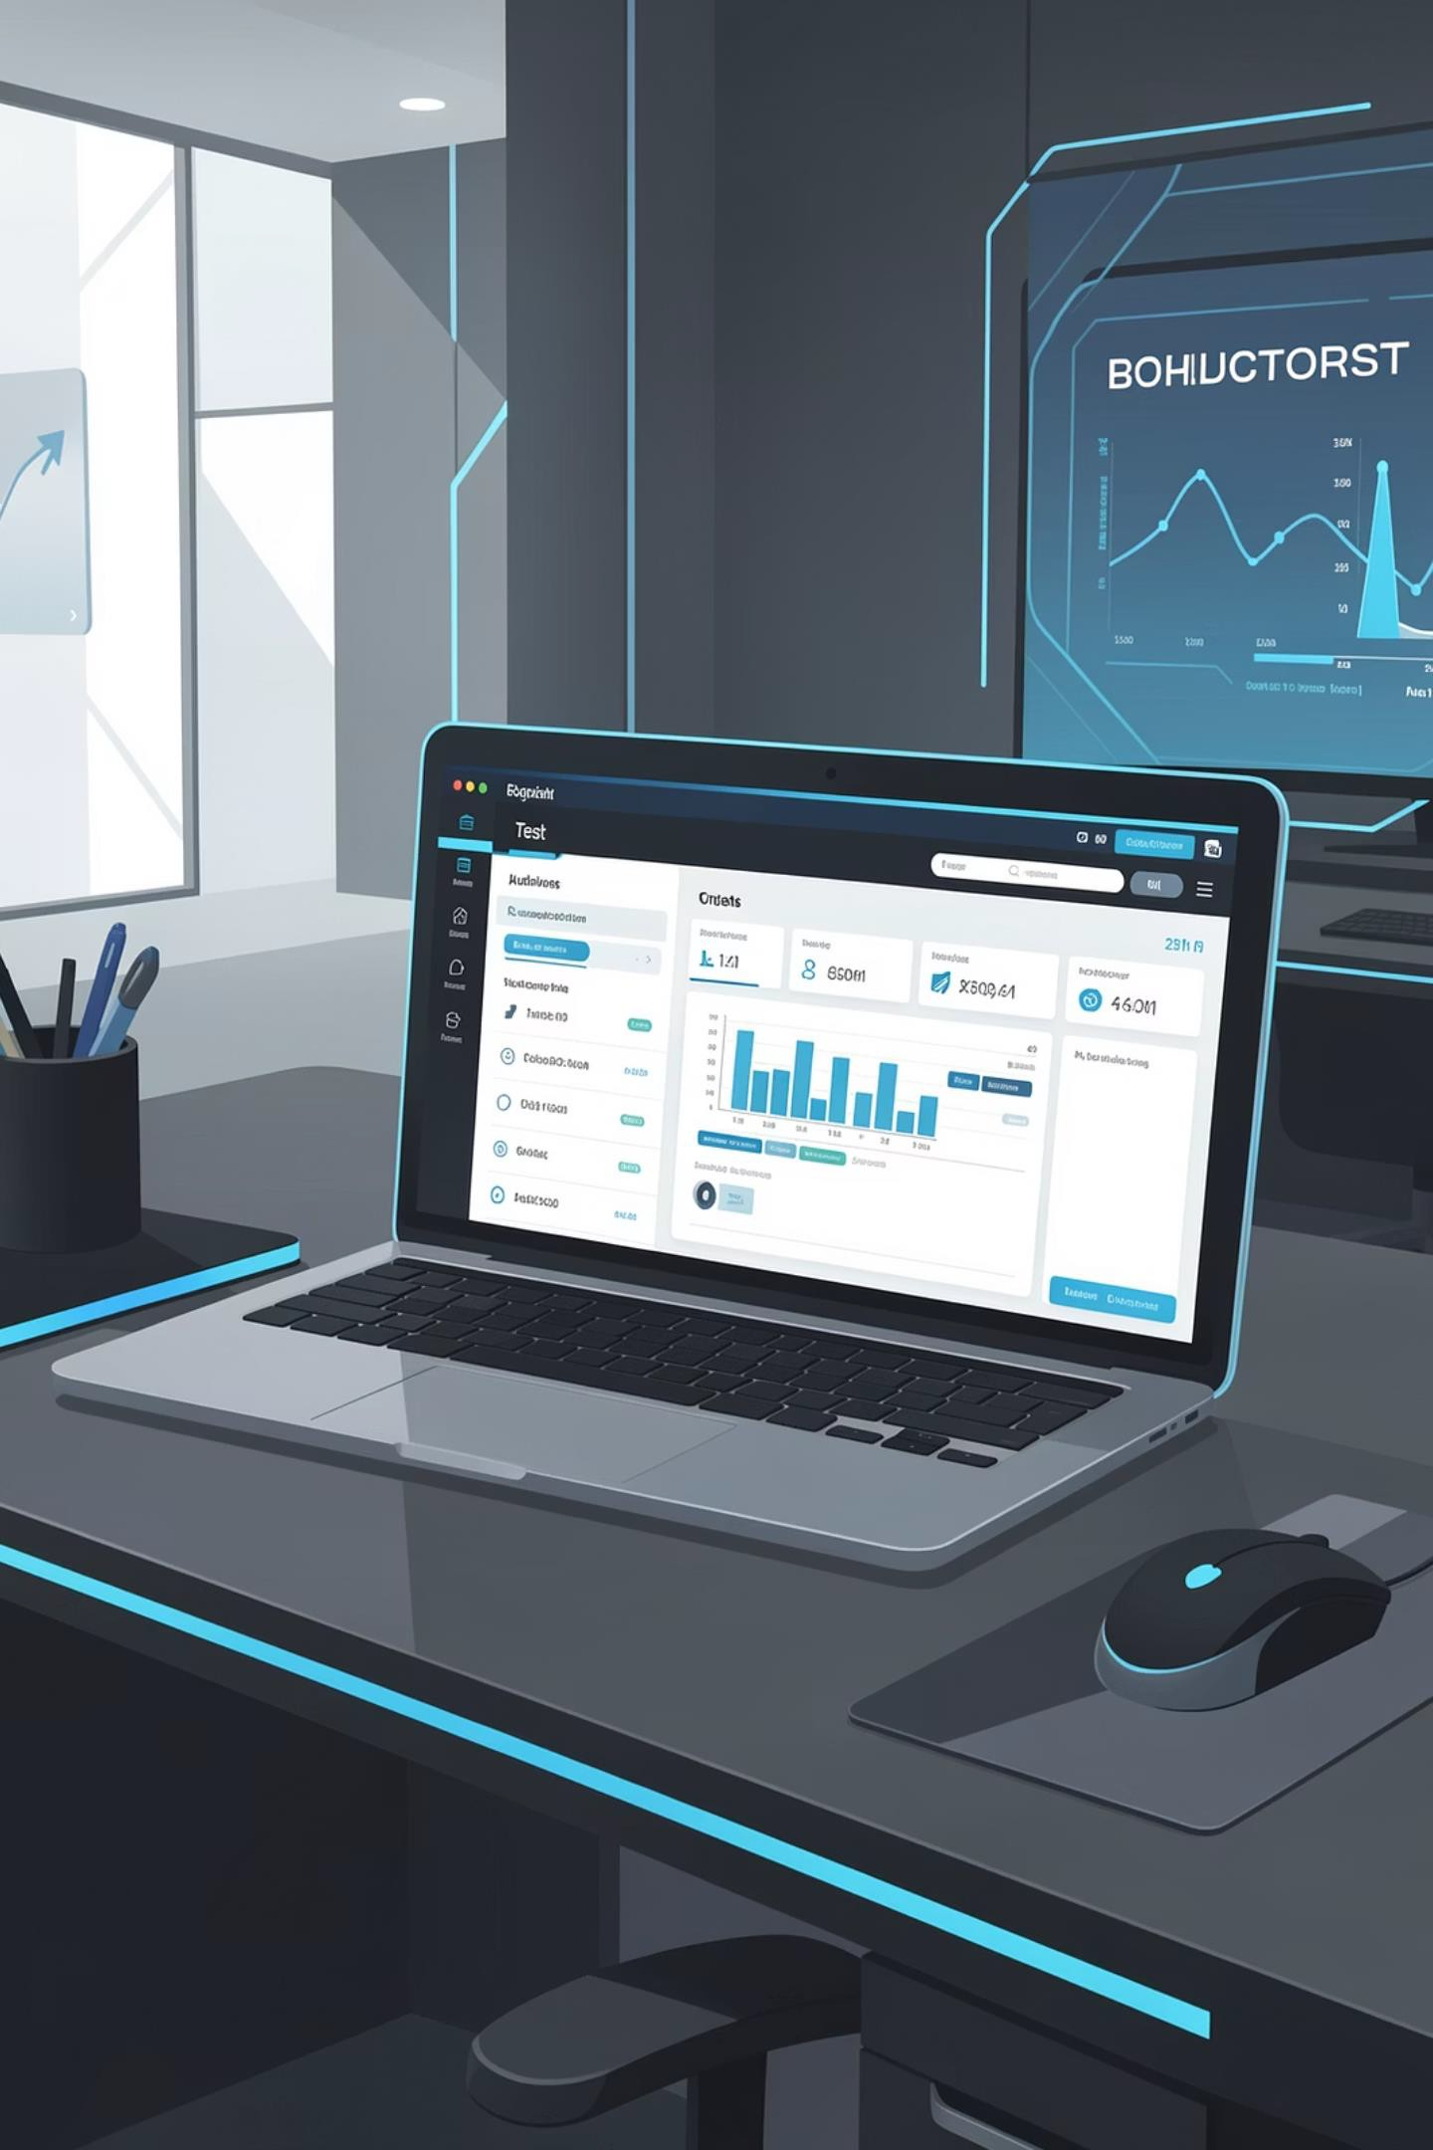
Booking Website Automation Framework
Airbnb Booking automation built with
Selenium, TestNG, Cucumber BDD, POM, Allure Reports, Log4j2 using Java + Maven.
Apoorv Vikram Singh
Coforge GET
50045791

Slide 2

Project Objective
Automate Core Flow
Search, date selection and results validation on a booking site.
Framework
Deliver readable tests, reusable components,
Reports,
screenshots, and logs.
Tools & Practices
Java ,Cucumber BDD, POM, TestNG,
Allure, Log4j2 for maintainability and visibility.

Slide 3
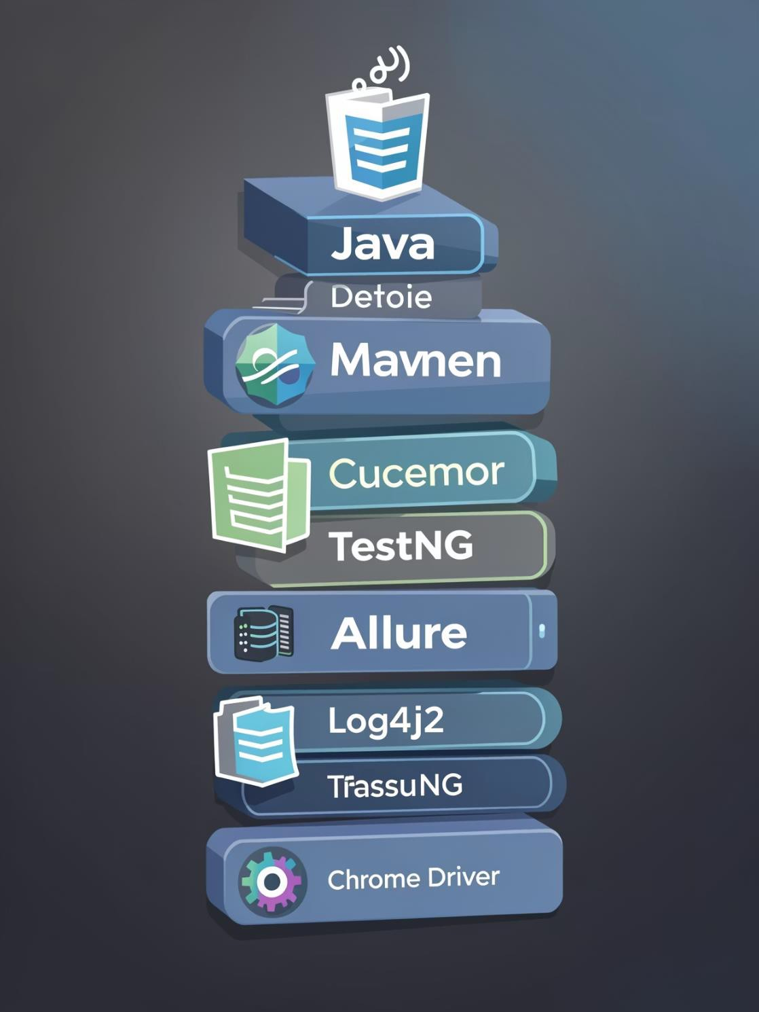


Tools & Technologies
Java + Maven
Language and build tool driving the framework.
Selenium WebDriver
Browser automation for end-to-end tests.
Cucumber BDD
Readable Gherkin scenarios for collaboration.
Allure & Log4j2
Rich reporting plus structured logging for debugging.

Slide 4
Framework Architecture
Key folders: src/main/java (base, pageObject), src/test/java (cucumber options, hooks, stepdefinitions), src/test/resources (features, log4j2.xml, data.properties), logs (automation.log, error.log).
Final_Project_01
├── src/main/java
│ ├── base → Base.java (WebDriver reference)
│ └── pageObject → HomePage.java (POM methods)
├── src/test/java
│ ├── cucumberoption → TestRunner.java (Cucumber + TestNG)
│ ├── hooks → TestHooks.java (Before/After, screenshots, logs)
│ └── stepdefinition → BookingSteps.java (step definitions)
├── src/test/resources
│ ├── features → booking_search_and_filter.feature
│ ├── log4j2.xml → Log configuration
│ └── data.properties → URL, test data
└── logs → automation.log, error.log

Slide 5

Cucumber : Feature & Scenario
Open Air BNB Web Page
Enter Destination
Select Check-in & Check-out Dates
Apply Search Button
Gherkin steps cover opening the page, searching 'Goa', selecting check-in/out and apply search results.

Slide 6
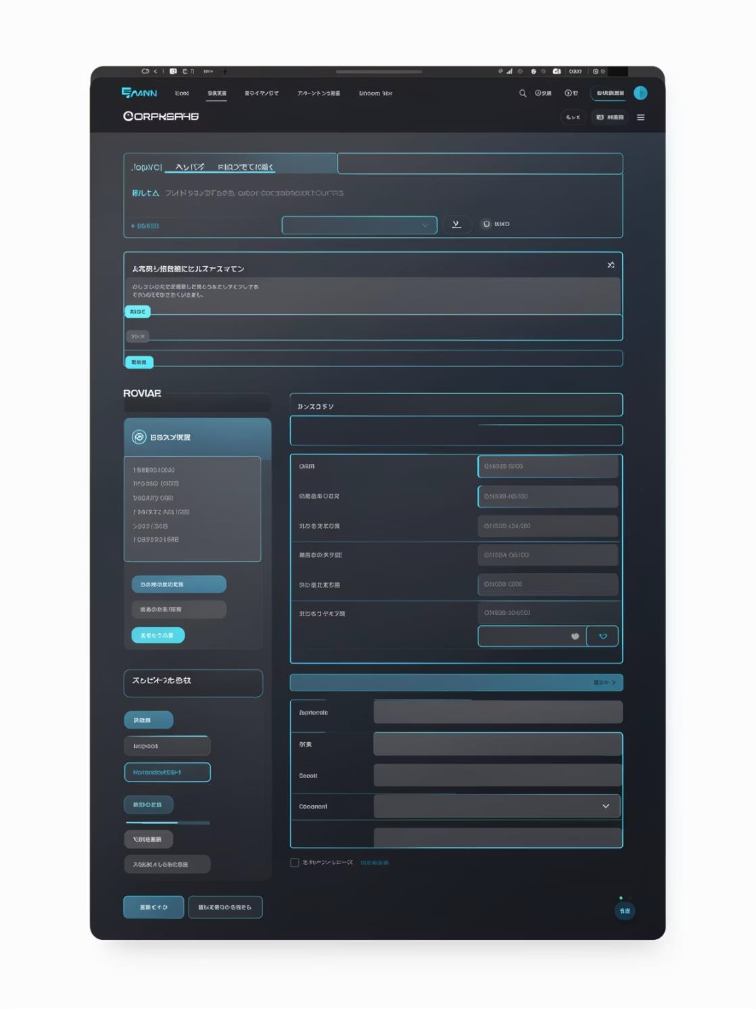
Page Object Model (POM)
HomePage.java
Centralizes locators (XPaths) and reusable methods: openCalendar(), clickByXpath(), selectDates(), enterDestination(), clickSearch().
Benefits
Reusability, reduced duplication, easier maintenance, and clearer test code.
Core Concept of POM
• Promotes code reusability across multiple test cases. • Significantly reduces duplicate code, making the framework lean.
• Simplifies maintenance efforts when UI changes occur, as only page object classes need updates.
• Enhances overall test readability and understanding

Slide 7
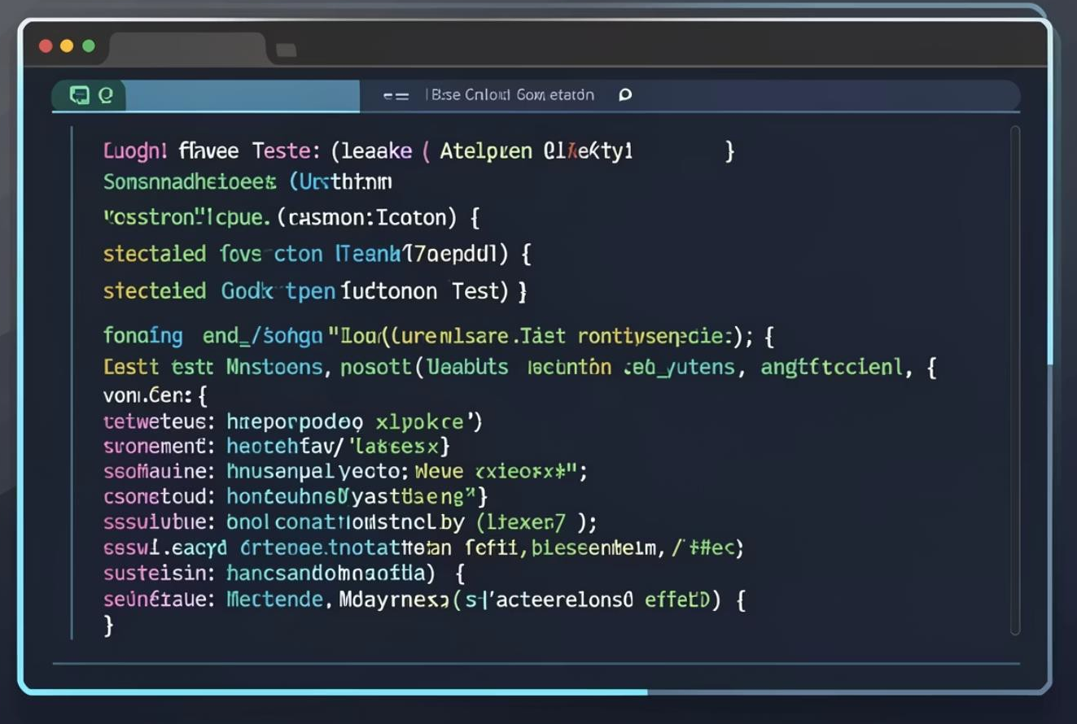
Step Definitions & Hooks
BookingSteps.java
Implements search, date selection, price filter, and result validation using POM methods.
TestHooks
Manages WebDriver lifecycle, attaches screenshots & logs to Allure, logs scenario status.
BookingSteps.java Responsibilities Manages various actions:
• Interactions with search boxes.
• Date selection logic.
• Applying price filters.
• Validation of test results.
Crucially, it calls POM methods to maintain a clean separation of concerns between test logic and page interactions
TestHooks.java Management Handles critical lifecycle events:
• WebDriver initialization before scenarios.
Proper WebDriver termination after scenarios.
• Capturing screenshots on both test success and failure.
• Attaching logs and screenshots directly to Allure reports.
• Logging scenario statuses for clear execution flow tracking

Slide 8
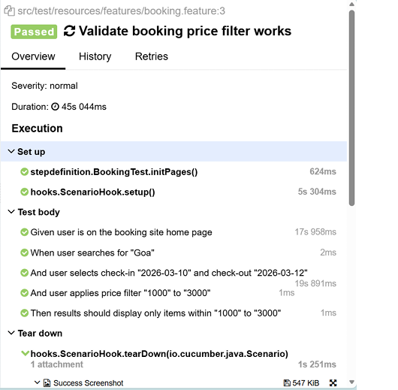
Allure Reporting
Dependency: allure-cucumber7-jvm
Attached screenshots on pass & fail
Attached automation logs
Command: allure serve target/allure-results

Slide 9
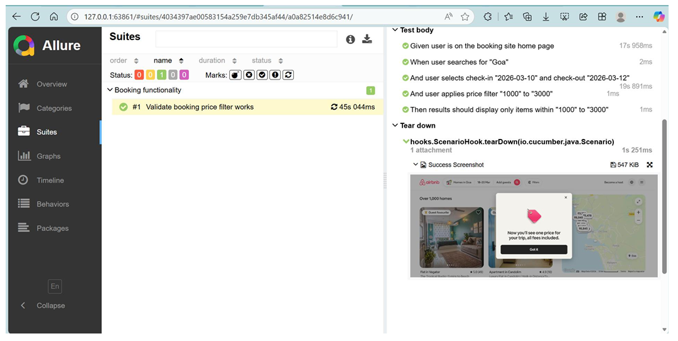
Allure Report: Screenshot For Success Case:

Slide 10
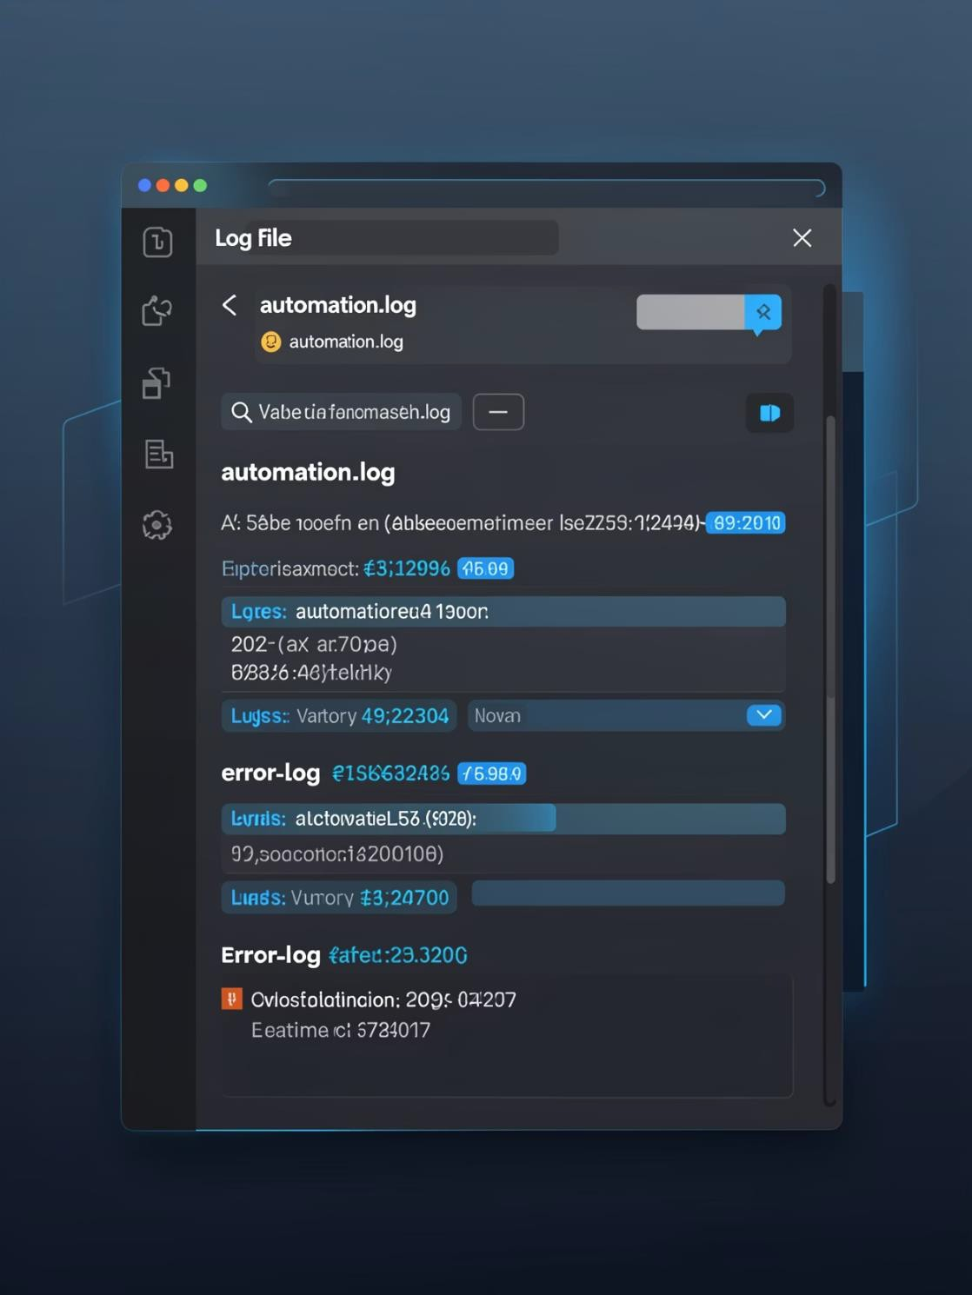
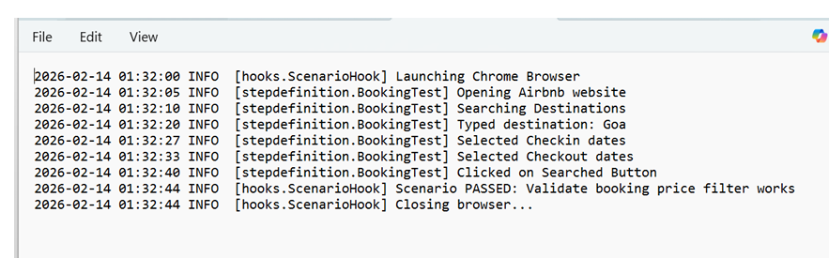
Logging with Log4j2
Files
automation.log (INFO/WARN/ERROR) and error.log (errors only).
Captured Events
Browser launch, navigation, clicks, date selection, failures, Closing.
Benefits
Simplifies debugging, supports development and production diagnostics, integrates with Allure.

Slide 11
Problem Faces during this project:
Unstable XPaths & Dynamic Elements
Issues selecting dates, search fields, and filters due to changing DOM.
Driver & Hook Initialization Errors
Faced multiple NullPointerException because WebDriver and POM were not initialized in correct order.
Cucumber Step & POM Mismatches
Incorrect step parameters and wrong method mapping caused test failures.
Reporting & Logging Setup Issues
Allure reports not generating and Log4j2 logs not appearing due to incorrect configuration.
Data & Integration Challenges
Handling date formats, test data inputs, and integrating CSV while keeping project stable.

Slide 12
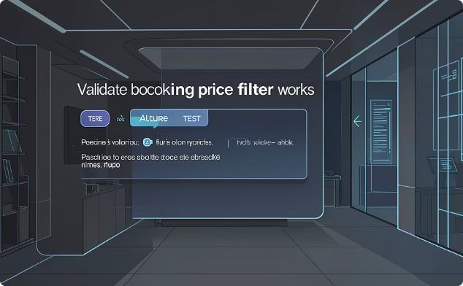
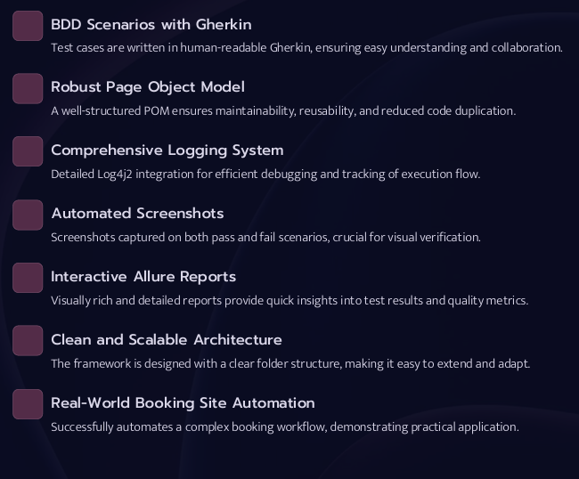

Achievements & Outcome
Final Outcome
Successful Automation
Automated booking workflow validated: search 'Goa', dates 2026-03-10 to 2026-
03-12,scenario passed in 45s 044ms.
Search → Dates → Price filter → Validation with screenshots and logs.
What We Learned
XPath crafting, POM design, Cucumber glue code, TestNG execution, Allure generation, log-driven debugging, Maven dependency management.

Slide 13
Thank You !!!

